Slide 1

PHP
FORMS

Slide 2







CHAPTER 3 - FORMS
WEB SERVER
CLIENT
CHAPTER 2
REQUEST
CHAPTER 3
WEB
FORMS
EXECUTE PHP CODE
CHAPTER 1
MANUPULATE
DATA
RESPONSE
WEB COOKIES
GENERATE HTML
CHAPTER 1

Slide 3

OBJECTIVES FOR TODAY
Understand the difference between GET and POST requests
Know how to get data from PHP using $_GET and $_POST
Redirecting a form after submission

Slide 4



PRACTICE
Activity 1-a
10 MIN
INDIV
Run the server (php -S localhost:80)
On the browser, write the following query:
Schema | http
Domain | localhost
Resource | action.php
parameters | name = rady
 | Email = rady@com
Check the display page is:
Add a new parameter to the query and update action.php to display it

Slide 5
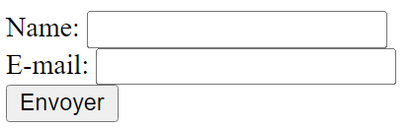
PRACTICE
Activity 1-b
10 MIN
INDIV
Run the server (php -S localhost:80)
On the browser, write the following query:
Schema | http
Domain | localhost
Resource | index.php
Complete the form and click on SEND
SEND
Q1 - Which query is executed when clicking on SEND ? (write the query)
Q2 - Which PHP file is executed when clicking on SEND ?

Slide 6



EXPLAIN
What’s happen when clicking on SEND ?
CLIENT
action="action.php"
name
AA
mail
BB
2
Request is sent to the server
SEND
1
A request is created
With the action and parameters
http://localhost/action.php?name=AA&mail=BB

Slide 7
EXPLAIN
What’s happen when clicking on SEND ?
CLIENT
WEB SERVER
http://localhost/action.php?name=AA&mail=BB
Your name is AA
Your mail is BB
EXECUTE PHP CODE
3
The server get the request
And return the HTML
GENERATE HTML

Slide 8

EXPLAIN
CLIENT
REQUEST URL
SERVER
http://localhost/action.php?name=sd&email=qsdqsd
1
2
3
A request is sent with
The action file all
All input value in the request
The server can access to the input value from
The URL
parameters
When click on submit button
<form action="action.php" method="get">
Name: <input type="text" name="name"><br>
E-mail: <input type="text" name="email"><br>
<button type="submit">SEND</button>
</form>
if (isset($_GET["name"]) {
echo $_GET["name"]
}

Slide 9
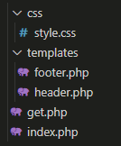
EXPLAIN
Structure your projects !
Header and footer of the application
File called when HTTP request is GET
The main view containg the FORM

Slide 10
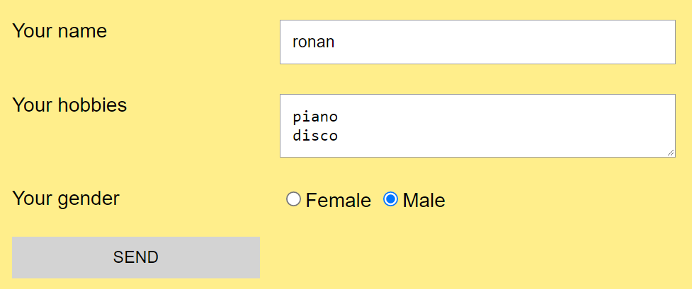
PRACTICE
Activity 2
15 MIN
INDIV
Complete the start code (index.php and get.php) to fulfill the below requirements :
Your name is ronan
Your hobbies are piano disco
You are a boy
http://localhost/get.php?name=ronan&hobbies=piano%0D%0Adisco&gender=male

Slide 11
DISCUSSION
With a GET request
information from client to server is stored on the URL :
http://localhost/action.php?name=Ronan&password=MyVerySecretPassword
CLIENT
SERVER
Q1 - What is the drawback of this method ?
Q2 - Do you have an idea to improve it ?

Slide 12
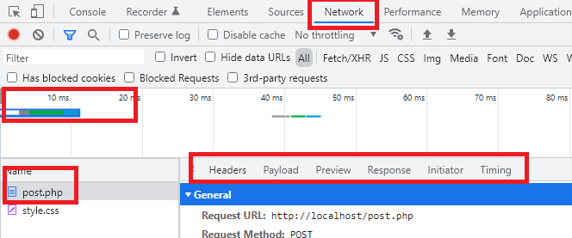
PRACTICE
Activity 3
15 MIN
GROUP 2
Compare the 2 way to send data to server (get-way and post-way projects)
What is the URL after clicking on SEND button
- on get-way ?
- on post-way ?
Open the Network tab : where are the parameters
- on get-way ?
- on post-way ?
With Network tab , observe
what a GET and a POST request are composed of

Slide 13
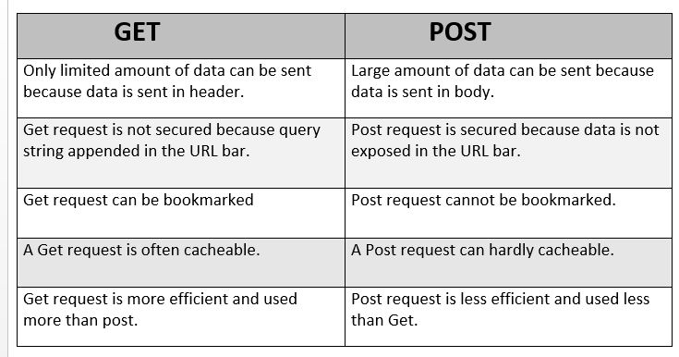
EXPLAIN
GET or POST ?
We use GET to get data from the server
Example : get the students of class wep21B
We use POST when we want to submit data to the server
Example : submit a form to add a new student in the database

Slide 14

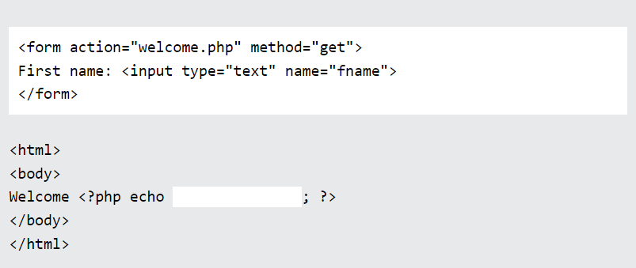
Complete the code to display the value from the "first name" field

Slide 15
Complete the code to display the value from the "first name" field
post

Slide 16
TRY IT
What’s happen if the parameter key is incorrect?
<form action=“post.php" method=“post">
<label>User Name: </label>
<input type="text" name="username" />
<input type="submit" name="sub" value="Send" />
</form>
<?php
$name = $_POST['user'];
echo "Your name is ".$name;
?>

Slide 17
GET or POST ?
Q1 – The fastest request
Q2 – Data are EXPOSED on the URL
Q3 – This request can be bookmarked
Q4 – The request can contain a file, an image….

Slide 18


HOMEWORK
PNC Club application !
INDIV
Write 2 PHP files:
index.php : the application from
result.php: the summary of the data submited
Name
Phandy
Club you want to apply
Robotic Club
Thx you Phandy !!
Be time for you
Saturday mornings
Saturday afternoons
Sunday afternoons
We received your application for the Robotic club
Yours skills
the best coder
good in arts
You are a crazy dancer and the best eater
a super star
a crazy dancer
singer
good in design
You will be available on Sunday afternoon
the best eater
good in speeches
SUBMIT !

